Slide 1
Android Application Development
MUHAMMAD NADZMI BIN MOHAMED IDZHAM

Slide 2
About Me
MUHAMMAD NADZMI BIN MOHAMED IDZHAM
BACHELOR in COMPUTER SCIENCE (Hons.)

Slide 3
Introduction to Android
OS = Android (based on Linux Kernel)
Touch gesture
Swiping
Tapping
Pinching
Sensors
Rotation
GPS
Open source

Slide 4
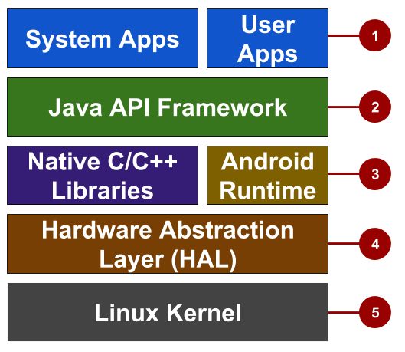
Android Platform Architecture

Slide 5
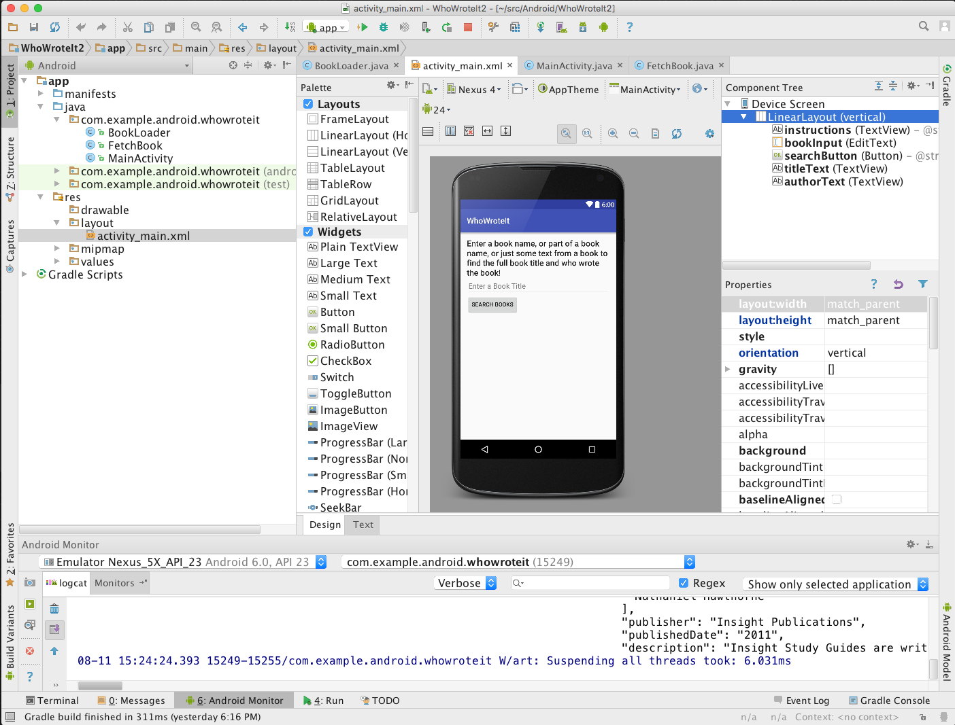
Android Studio
Official Android IDE
From Jetbrains Company

Slide 6
Android Software Development Kit (SDK)
Development tools
Libraries
Virtual device (emulators)
Documentations
Sample code

Slide 7
Application Development (Main factors)
Resources
Layout (front-end)
values
Components (back-end)
Java codes
Manifest
Application information during runtime
Build configuration
.apk configuration (in Gradle configuration file)

Slide 8
Today’s agenda
Create new empty project
File structures
Deploy app
UI
Layouts
Views
Components
Activities
Moving between activities
Exchange data between activities
Asynctask Activities
Exchange data between activities
Extra
SQLite database
Remote database

